Slide 1
UNIT-V
Data Link Layer

Slide 2
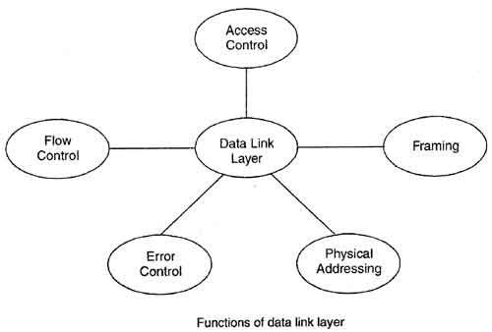

Slide 3
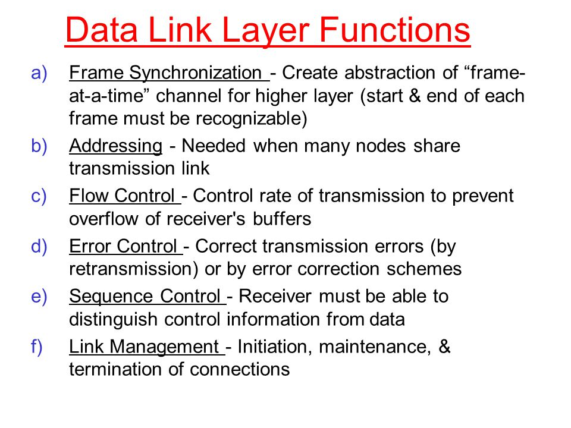

Slide 4
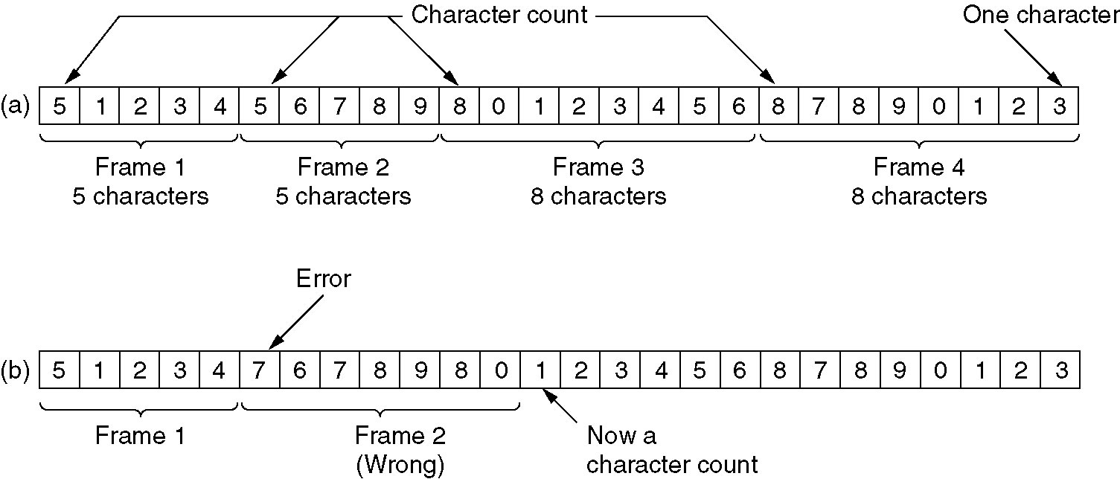
Framing
A character stream. (a) Without errors. (b) With one error.

Slide 5
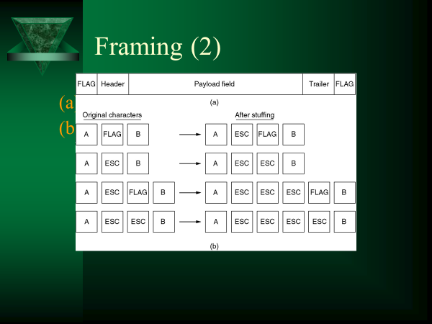

Slide 6
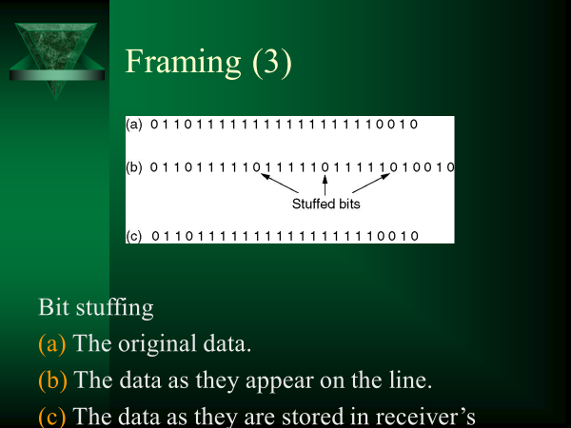

Slide 7
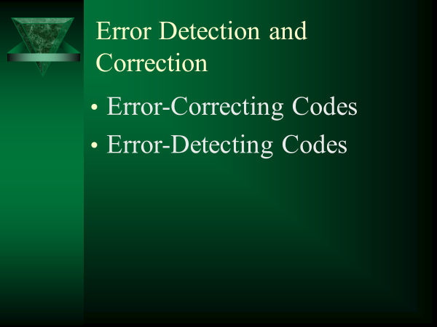

Slide 8
Basic concepts
Networks must be able to transfer data from one device to another with complete accuracy.
Data can be corrupted during transmission.
For reliable communication, errors must be detected and corrected.
Error detection and correction are implemented either at the data link layer or the transport layer of the OSI model.

Slide 10
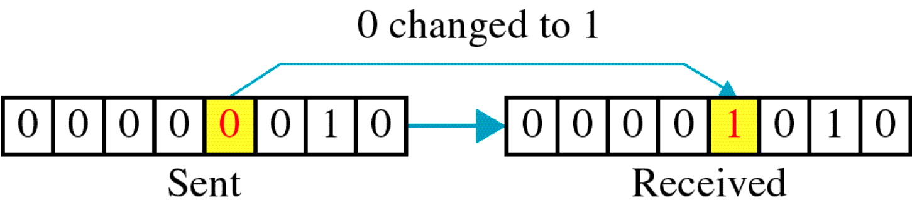
SINGLE BIT ERROR

Slide 11
Single bit errors are the least likely type of errors in serial data transmission because the noise must have a very short duration which is very rare. However this kind of errors can happen in parallel transmission.
Example:
If data is sent at 1Mbps then each bit lasts only 1/1,000,000 sec. or 1 μs.
For a single-bit error to occur, the noise must have a duration of only 1 μs, which is very rare.

Slide 12
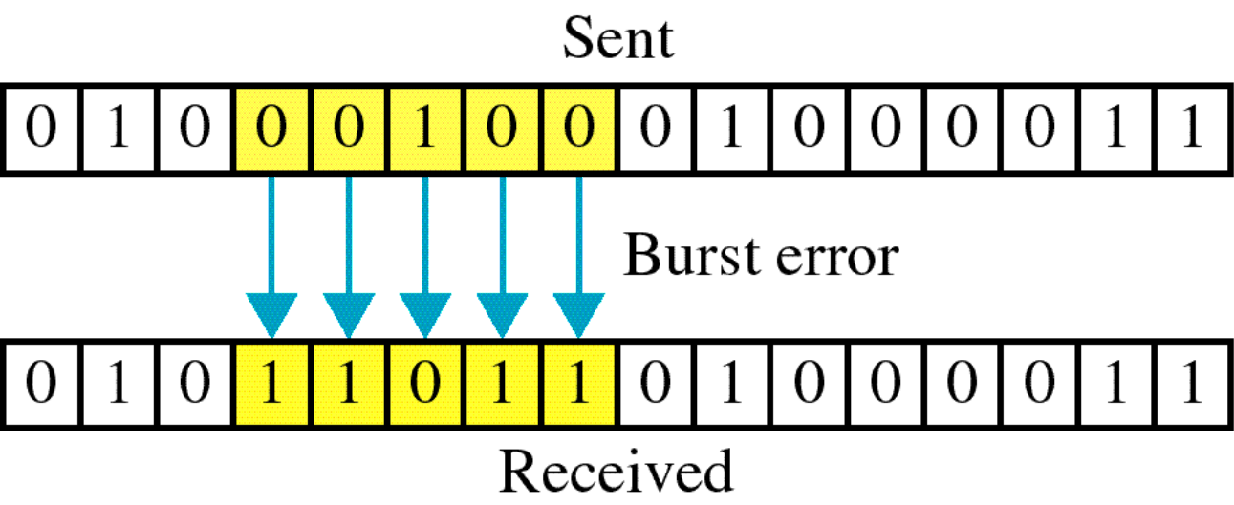
BURST ERROR

Slide 14
The term burst error means that two or more bits in the data unit have changed from 1 to 0 or from 0 to 1.
Burst errors does not necessarily mean that the errors occur in consecutive bits, the length of the burst is measured from the first corrupted bit to the last corrupted bit. Some bits in between may not have been corrupted.

Slide 15
Burst error is most likely to happen in serial transmission since the duration of noise is normally longer than the duration of a bit.
The number of bits affected depends on the data rate and duration of noise.
Example:
If data is sent at rate = 1Kbps then a noise of 1/100 sec can affect 10 bits.(1/100*1000)
If same data is sent at rate = 1Mbps then a noise of 1/100 sec can affect 10,000 bits.(1/100*10⁶)

Slide 16
Transmission Errors
Content Error
Error detection &Error correction ,Bit error rate , Error detection methods: Parity checking ,
Checksum Error Detection ,
Cyclic Redundancy Check ,
Hamming code , Interleaved codes , Block Parity , Convolution code.

Slide 17
Transmission Errors
Transmission errors are caused by:
thermal noise {Shannon}
impulse noise (e..g, arcing relays)
signal distortion during transmission (attenuation)
crosstalk
voice amplitude signal compression (companding)
quantization noise (PCM)
jitter (variations in signal timings)
receiver and transmitter out of synch.

Slide 18
Error Detection and Correction
error detection :: adding enough “extra” bits to deduce that there is an error but not enough bits to correct the error.
If only error detection is employed in a network transmission ➔ retransmission is necessary to recover the frame (data link layer) or the packet (network layer).
At the data link layer, this is referred to as ARQ (Automatic Repeat reQuest).

Slide 19
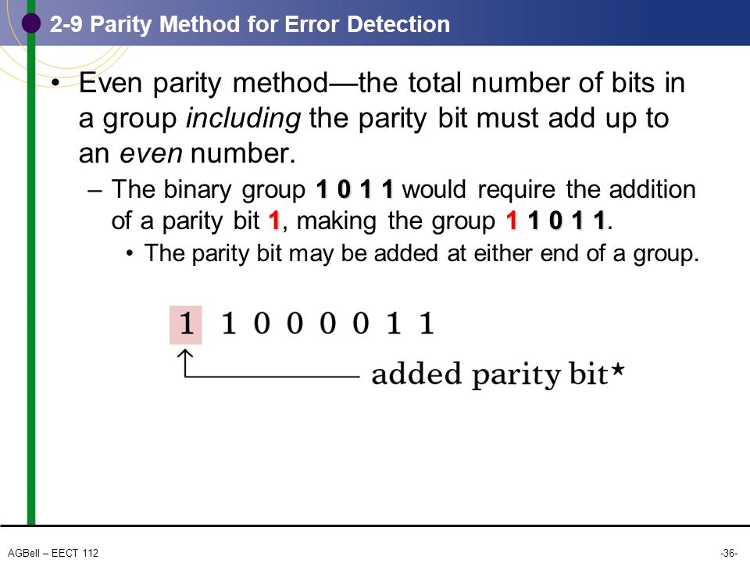

Slide 20
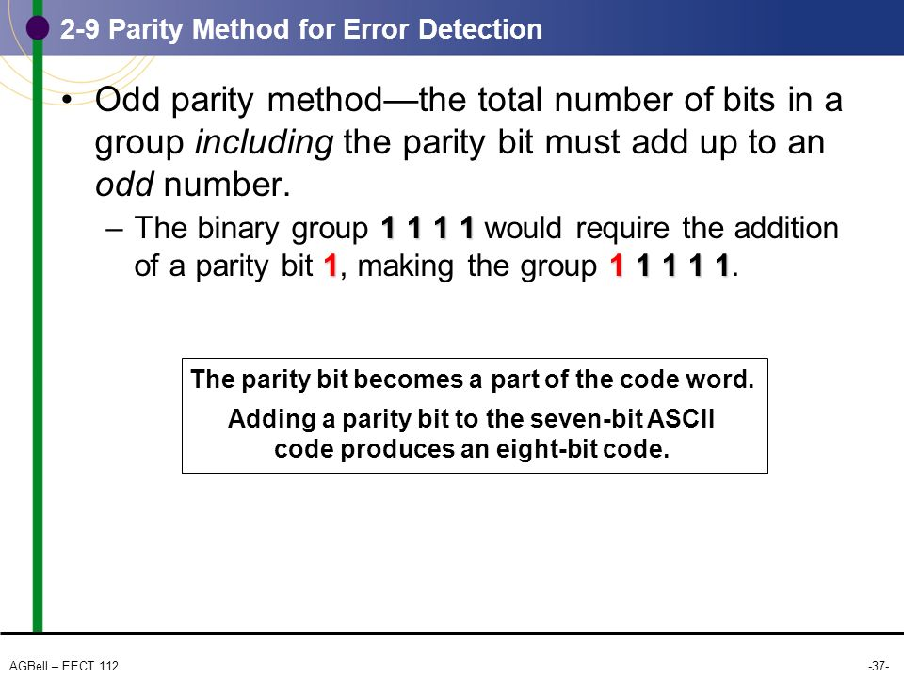

Slide 21
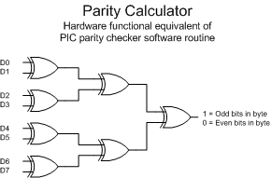

Slide 22
Error Detection and Correction
error correction :: requires enough additional (redundant) bits to deduce what the correct bits must have been.
Examples
Hamming Codes
FEC = Forward Error Correction found in MPEG-4.

Slide 23
Hamming Codes
codeword :: a legal dataword consisting of m data bits and r redundant bits.
Error detection involves determining if the received message matches one of the legal codewords.
Hamming distance :: the number of bit positions in which two bit patterns differ.
Starting with a complete list of legal codewords, we need to find the two codewords whose Hamming distance is the smallest. This determines the Hamming distance of the code.

Slide 24
General algorithm
The following general algorithm generates correcting (SEC) code for any number of bits.
Number the bits starting from 1: bit 1, 2, 3, 4, 5, etc.
Write the bit numbers in binary: 1, 10, 11, 100, 101, etc.
All bit positions that are powers of two (have a single 1 bit in the binary form of their position) are parity bits: 1, 2, 4, 8, etc. (1, 10, 100, 1000)
All other bit positions, with two or more 1 bits in the binary form of their position, are data bits.
Each data bit is included in a unique set of 2 or more parity bits, as determined by the binary form of its bit position.
Parity bit 1 covers all bit positions which have the least significant bit set: bit 1 (the parity bit itself), 3, 5, 7, 9, etc.
Parity bit 2 covers all bit positions which have the second least significant bit set: bit 2 (the parity bit itself), 3, 6, 7, 10, 11, etc.
Parity bit 4 covers all bit positions which have the third least significant bit set: bits 4–7, 12–15, 20–23, etc.
Parity bit 8 covers all bit positions which have the fourth least significant bit set: bits 8–15, 24–31, 40–47, etc.

Slide 26
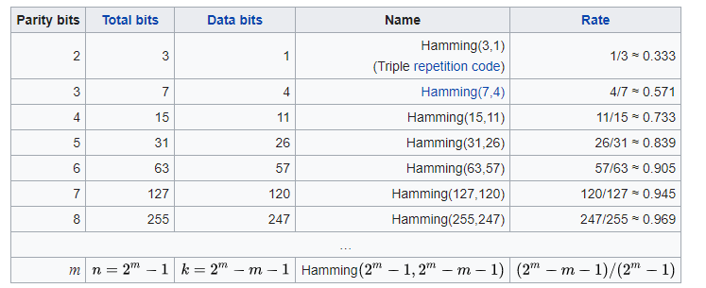

Slide 27
design a code with m message bits and r check bits that will allow all single errors to be corrected.
Each of the 2^{m} legal messages has n illegal codewords at a distance 1 from it.
Thus, each of the 2^{m} legal messages requires n + 1 bit patterns dedicated to it. Since the total number of bit patterns is 2^{n}, we must have (n + 1) 2^{m} ≤ 2^{n}.

Slide 28
Using n = m + r, this requirement becomes (m + r + 1) ≤ 2r.
Given m, this puts a lower limit on the number of check bits needed to correct single errors.

Slide 29
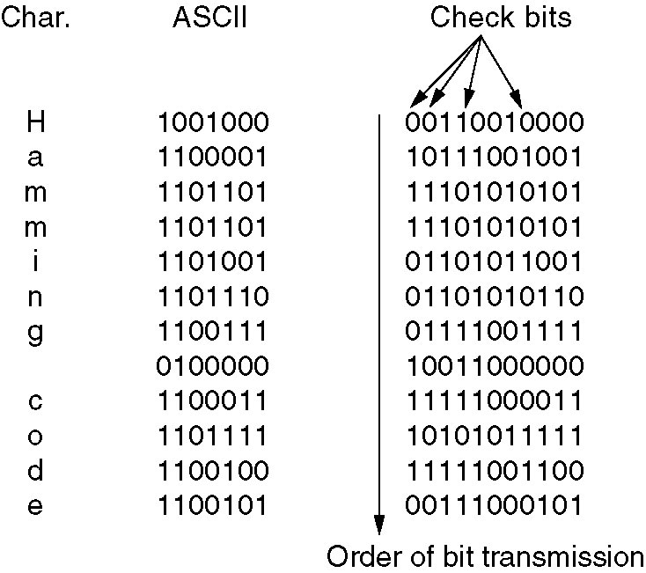
Error Correcting Codes
Note
Check bits occupy
power of 2 slots

Slide 30
Hamming Codes
To detect d single bit errors, you need a d+1 code distance.
To correct d single bit errors, you need a 2d+1 code distance.
In general, the price for redundant bits is too expensive to do error correction for network messages.
Network protocols use error detection and ARQ.

Slide 31
Before giving the general characteristics of the Hamming code, we will illustrate its operation with a data word of eight bits.
Consider, for example, the 8-bit data word 11000100. We include four parity bits with this word and arrange the 12 bits as follows:
Bit position 1 2 3 4 5 6 7 8 9 10 11 12
P1 P2 1 P4 1 0 0 P8 0 1 0 0

Slide 35
A 0 check bit designates an even parity over the checked bits, and a 1 designates an odd parity. Since the bits were written with even parity, the result, C C8C4C2C1 0000, indicates that no error has occurred. However, if , the 4-bit binary number formed by the check bits gives the position of the erroneous bit if only a single bit is in error. For example, consider the following three cases:

Slide 37
Error Detection
Remember – errors in network transmissions are bursty.
The percentage of damage due to errors is lower.
It is harder to detect and correct network errors.
Linear codes
Single parity check code :: take k information bits and appends a single check bit to form a codeword.
Two-dimensional parity checks
IP Checksum
Polynomial Codes
Example: CRC (Cyclic Redundancy Checking)

Slide 38

Information bits
Received information bits
Recalculate check bits
Channel
Calculate check bits
Compare
Check
bits
Received check bits

Slide 39
Four types of redundancy checks are used in data communications

Slide 40
Vertical Redundancy Check VRC

Slide 41
Performance
It can detect single bit error
It can detect burst errors only if the total number of errors is odd.

Slide 42
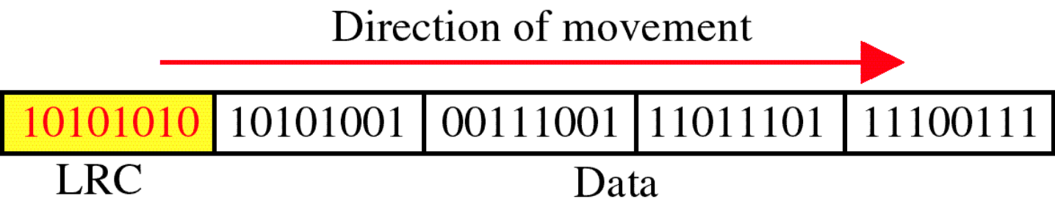
Longitudinal Redundancy Check LRC

Slide 43
Performance
LCR increases the likelihood of detecting burst errors.
If two bits in one data units are damaged and two bits in exactly the same positions in another data unit are also damaged, the LRC checker will not detect an error.

Slide 44
VRC and LRC

Slide 45
Cyclic Redundancy Check
CRC

Slide 46
Cyclic Redundancy Check
Given a k-bit frame or message, the transmitter generates an n-bit sequence, known as a frame check sequence (FCS), so that the resulting frame, consisting of (k+n) bits, is exactly divisible by some predetermined number.
The receiver then divides the incoming frame by the same number and, if there is no remainder, assumes that there was no error.

Slide 47
Binary Division

Slide 49
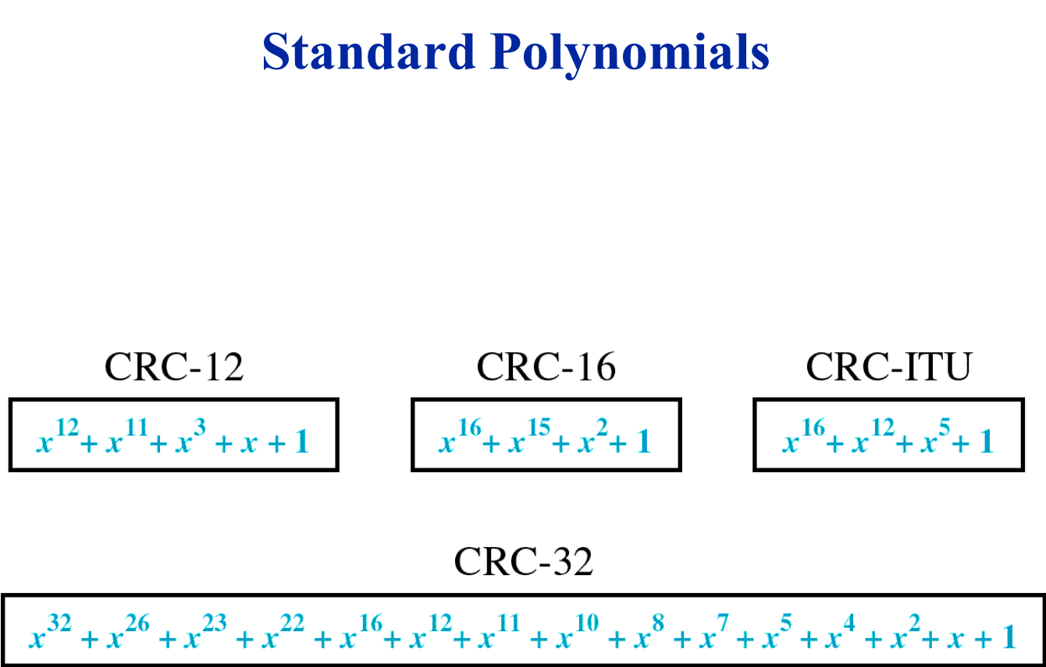

Slide 50
At the sender
The unit is divided into k sections, each of n bits.
All sections are added together using one’s complement to get the sum.
The sum is complemented and becomes the checksum.
The checksum is sent with the data

Slide 51
At the receiver
The unit is divided into k sections, each of n bits.
All sections are added together using one’s complement to get the sum.
The sum is complemented.
If the result is zero, the data are accepted: otherwise, they are rejected.

Slide 52
Performance
The checksum detects all errors involving an odd number of bits.
It detects most errors involving an even number of bits.
If one or more bits of a segment are damaged and the corresponding bit or bits of opposite value in a second segment are also damaged, the sums of those columns will not change and the receiver will not detect a problem.

Slide 53
Error Correction
It can be handled in two ways:
receiver can have the sender retransmit the entire data unit.
The receiver can use an error-correcting code, which automatically corrects certain errors.

Slide 54
FLOW CONTROL
Flow control coordinates the amount of data that can be sent before receiving acknowledgement
It is one of the most important functions of data link layer.
Flow control is a set of procedures that tells the sender how much data it can transmit before it must wait for an acknowledgement from the receiver.
Receiver has a limited speed at which it can process incoming data and a limited amount of memory in which to store incoming data.
Receiver must inform the sender before the limits are reached and request that the transmitter to send fewer frames or stop temporarily.
Since the rate of processing is often slower than the rate of transmission, receiver has a block of memory (buffer) for storing incoming data until they are processed.

Slide 55
Elementary Data Link Protocols
machine A wants to send a long stream of data to machine B,
reliable, connection-oriented service.
Later, we will consider the case where B also wants to send data to A simultaneously.
A is assumed to have an infinite supply of data ready to send and never has to wait for data to be produced.
Instead, when A's data link layer asks for data, the network layer is always able to comply immediately. (This restriction, too, will be dropped later.)

Slide 56
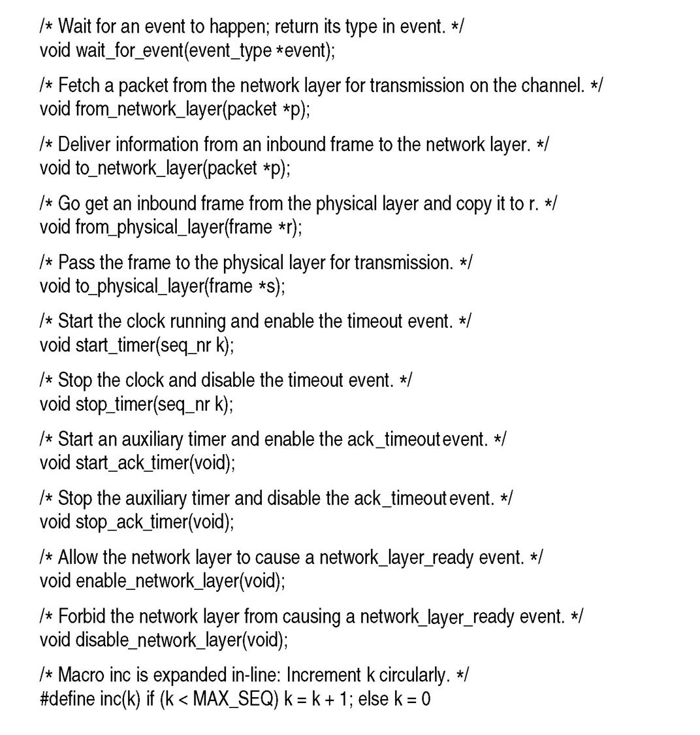

Slide 57
(event = cksum_err).
(event = frame_arrival)
Five data structures are defined there: boolean, seq_nr, packet, frame_kind, and frame.
frame is composed of four fields: kind, seq, ack, and info,

Slide 58
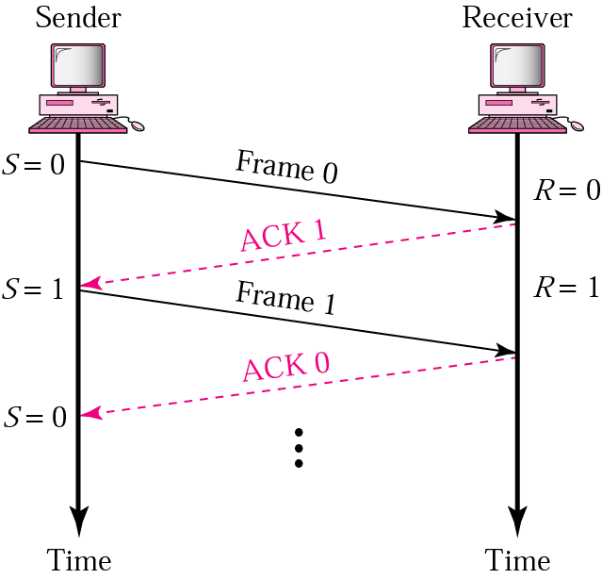
Stop-and-Wait
Sender keeps a copy of the last frame until it receives an acknowledgement.
For identification, both data frames and acknowledgements (ACK) frames are numbered alternatively 0 and 1.
Sender has a control variable (S) that holds the number of the recently sent frame. (0 or 1)
Receiver has a control variable ® that holds the number of the next frame expected (0 or 1).
Sender starts a timer when it sends a frame. If an ACK is not received within a allocated time period, the sender assumes that the frame was lost or damaged and resends it
Receiver send only positive ACK if the frame is intact.
ACK number always defines the number of the next expected frame

Slide 59
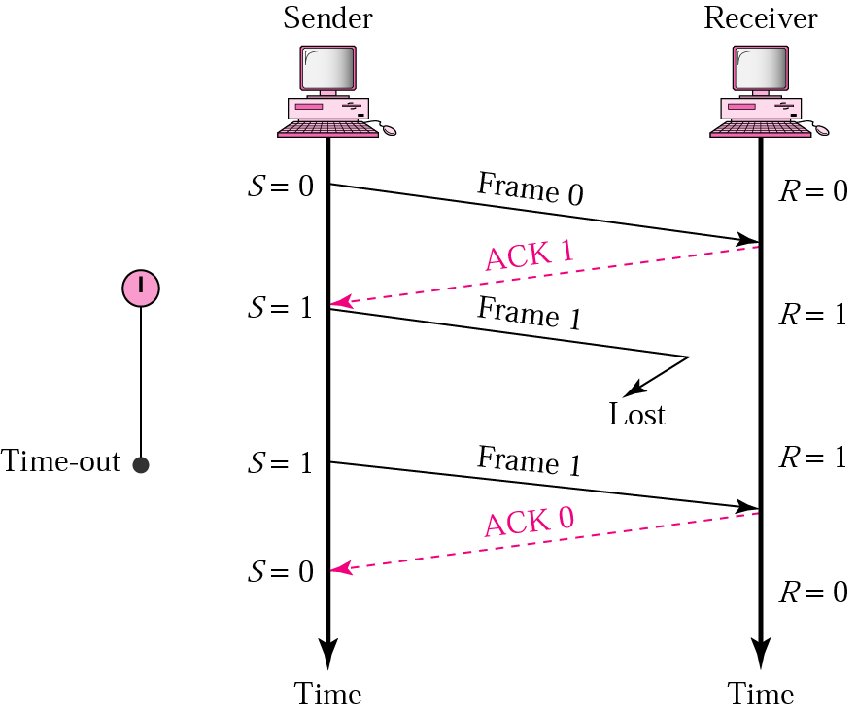
Stop-and-Wait ARQ, lost ACK frame
When a receiver receives a damaged frame, it discards it and keeps its value of R.
After the timer at the sender expires, another copy of frame 1 is sent.

Slide 60
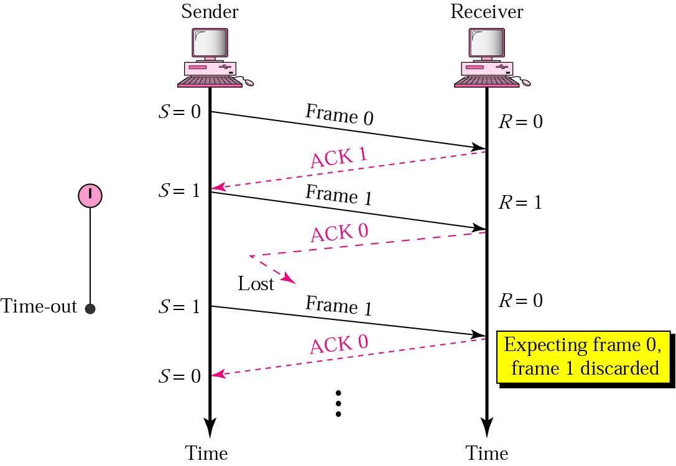
Stop-and-Wait, lost ACK frame
If the sender receives a damaged ACK, it discards it.
When the timer of the sender expires, the sender retransmits frame 1.
Receiver has already received frame 1 and expecting to receive frame 0 (R=0). Therefore it discards the second copy of frame 1.

Slide 61
A Simplex Protocol for a Noisy Channel
Consider the following scenario:
The network layer on A gives packet 1 to its data link layer. The packet is correctly received at B and passed to the network layer on B. B sends an acknowledgement frame back to A.
The acknowledgement frame gets lost completely. It just never arrives at all. Life would be a great deal simpler if the channel mangled and lost only data frames and not control frames, but sad to say, the channel is not very discriminating.
The data link layer on A eventually times out. Not having received an acknowledgement, it (incorrectly) assumes that its data frame was lost or damaged and sends the frame containing packet 1 again.
The duplicate frame also arrives at the data link layer on B perfectly and is unwittingly passed to the network layer there. If A is sending a file to B, part of the file will be duplicated (i.e., the copy of the file made by B will be incorrect and the error will not have been detected). In other words, the protocol will fail.

Slide 62
What is the minimum number of bits needed for the sequence number?
The only ambiguity in this protocol is between a frame, m, and its direct successor, m + 1.
If frame m is lost or damaged, the receiver will not acknowledge it, so the sender will keep trying to send it.
Once it has been correctly received, the receiver will send an acknowledgement to the sender.
It is here that the potential trouble crops up. Depending upon whether the acknowledgement frame gets back to the sender correctly or not, the sender may try to send m or m + 1.

Slide 63
The event that triggers the sender to start sending frame m + 2 is the arrival of an acknowledgement for frame m + 1.
But this implies that m has been correctly received, and furthermore that its acknowledgement has also been correctly received by the sender (otherwise, the sender would not have begun with m + 1, let alone m + 2).
As a consequence, the only ambiguity is between a frame and its immediate predecessor or successor, not between the predecessor and successor themselves.

Slide 64
A 1-bit sequence number (0 or 1) is therefore sufficient.
At each instant of time, the receiver expects a particular sequence number next. Any arriving frame containing the wrong sequence number is rejected as a duplicate.
When a frame containing the correct sequence number arrives, it is accepted and passed to the network layer. Then the expected sequence number is incremented modulo 2 (i.e., 0 becomes 1 and 1 becomes 0).

Slide 66
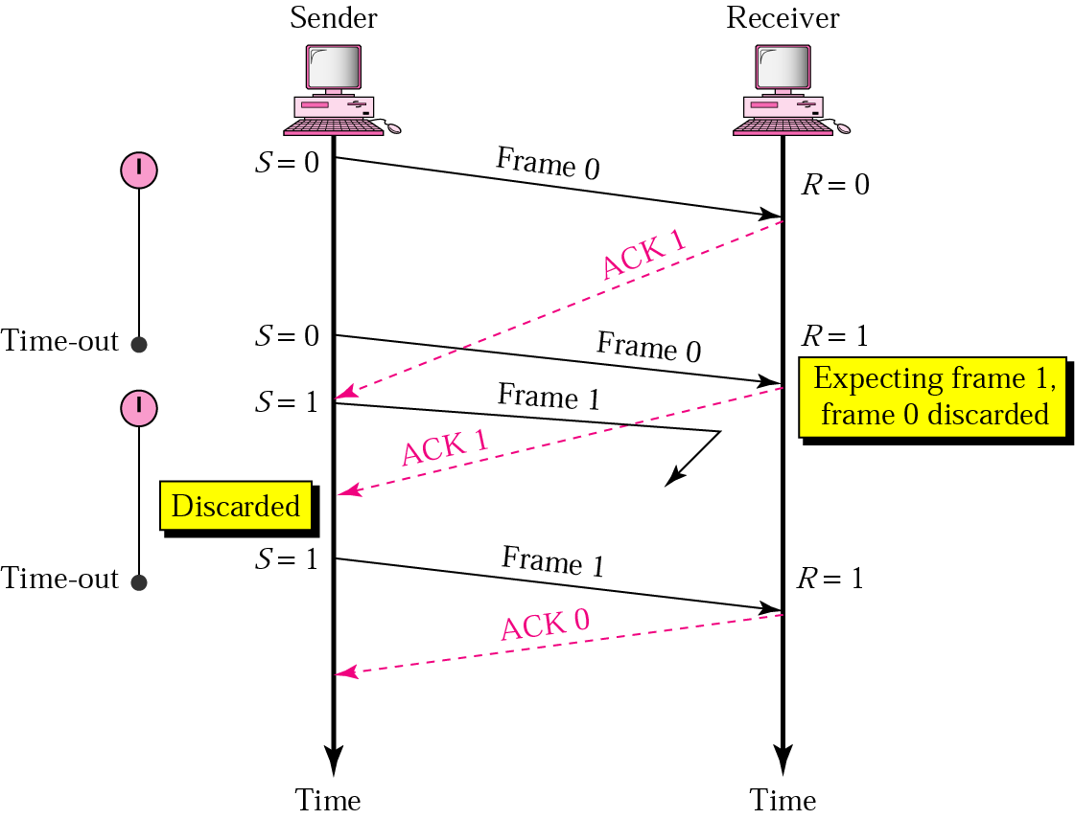
Stop-and-Wait, delayed ACK frame
The ACK can be delayed at the receiver or due to some problem
It is received after the timer for frame 0 has expired.
Sender retransmitted a copy of frame 0. However, R =1 means receiver expects to see frame 1. Receiver discards the duplicate frame 0.
Sender receives 2 ACKs, it discards the second ACK.

Slide 67
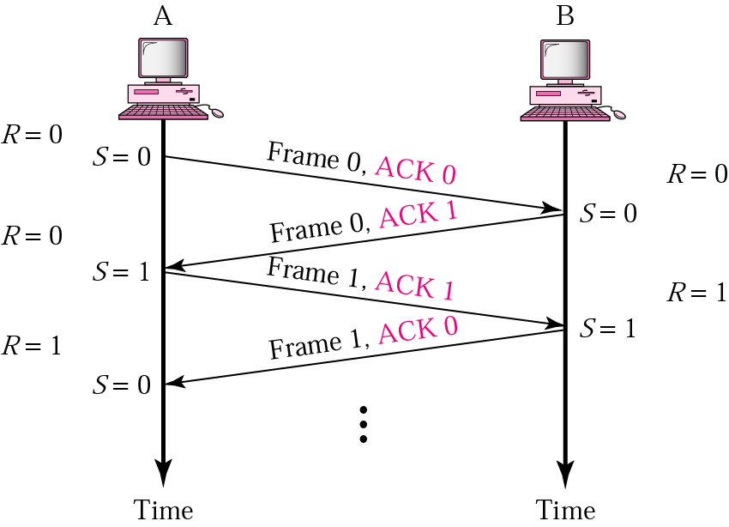
Piggybacking
A method to combine a data frame with ACK.
Station A and B both have data to send.
Instead of sending separately, station A sends a data frame that includes an ACK.
Station B does the same thing.
Piggybacking saves bandwidth.

Slide 68
Disadvantage of Stop-and-Wait
In stop-and-wait, at any point in time, there is only one frame that is sent and waiting to be acknowledged.
This is not a good use of transmission medium.
To improve efficiency, multiple frames should be in transition while waiting for ACK.
Two protocol use the above concept,
Go-Back-N ARQ
Selective Repeat ARQ

Slide 69
Go-Back-N ARQ
We can send up to W frames before worrying about ACKs.
We keep a copy of these frames until the ACKs arrive.
This procedure requires additional features to be added to Stop-and-Wait ARQ.

Slide 70
Sequence Numbers
Frames from a sender are numbered sequentially.
We need to set a limit since we need to include the sequence number of each frame in the header.
If the header of the frame allows m bits for sequence number, the sequence numbers range from 0 to 2 ^{m} – 1. for m = 3, sequence numbers are: 1, 2, 3, 4, 5, 6, 7.
We can repeat the sequence number.
Sequence numbers are:
0, 1, 2, 3, 4, 5, 6, 7, 0, 1, 2, 3, 4, 5, 6, 7, 0, 1, …

Slide 71
Sliding Window Protocols
A One-Bit Sliding Window Protocol
A Protocol Using Go Back N
A Protocol Using Selective Repeat

Slide 72
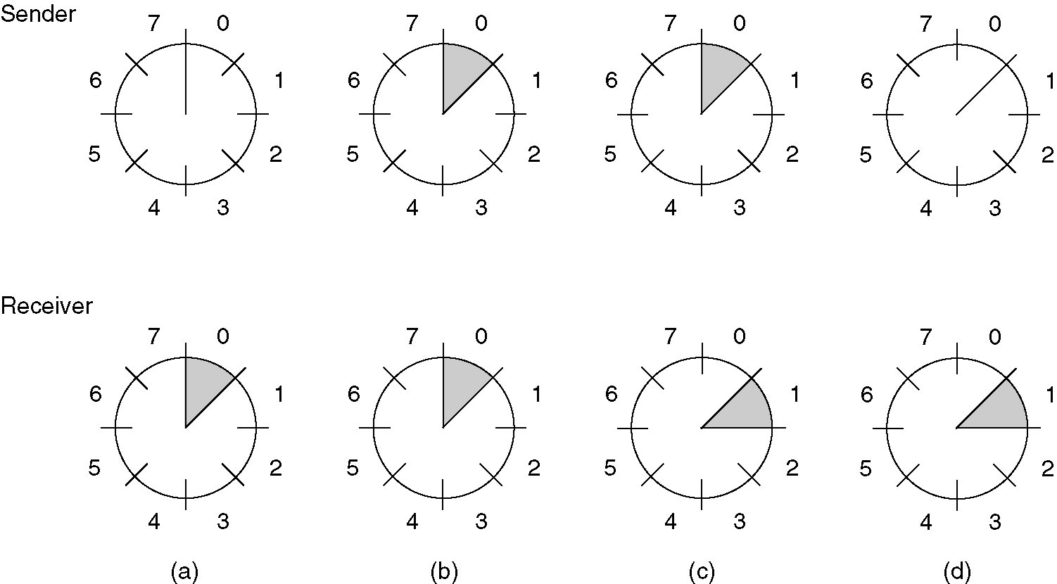
A sliding window of size 1, with a 3-bit sequence number.
(a) Initially.
(b) After the first frame has been sent.
(c) After the first frame has been received.
A sliding window of size 1, with a 3-bit sequence number.
(a) Initially.
(b) After the first frame has been sent.
(c) After the first frame has been received.

Slide 73
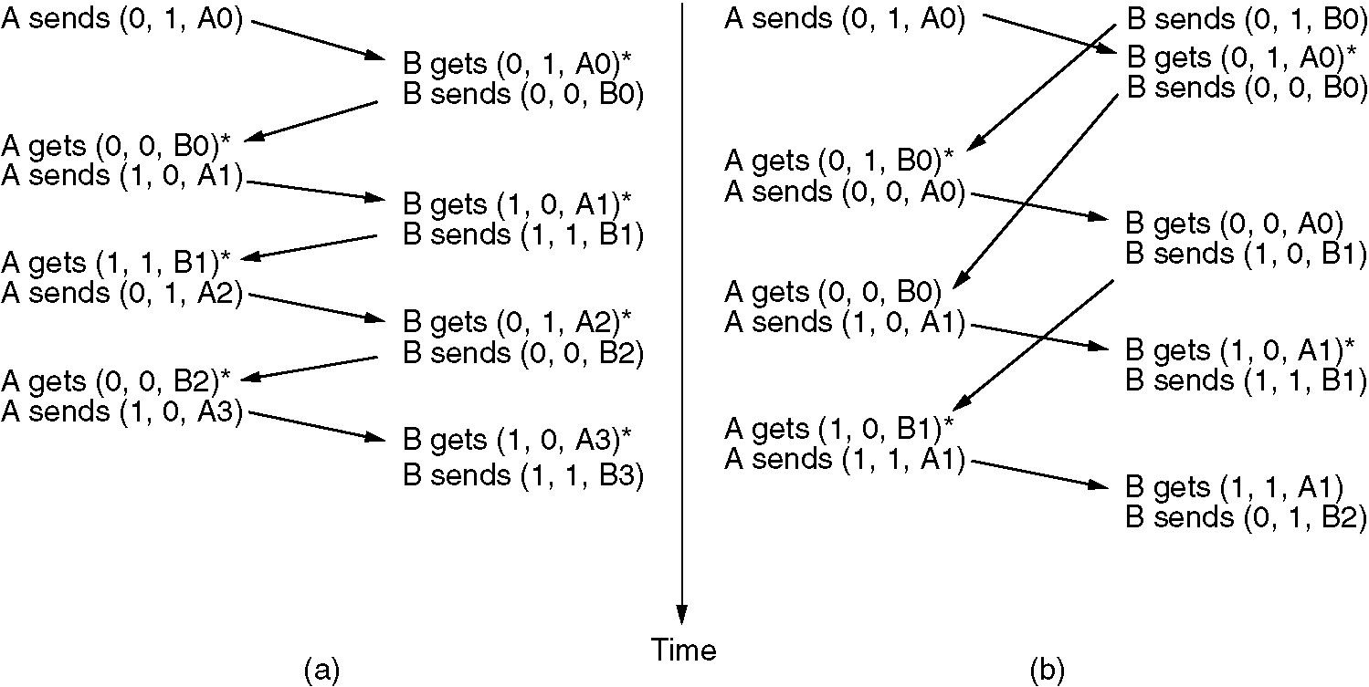
A One-Bit Sliding Window Protocol (2)
Two scenarios for protocol 4. (a) Normal case. (b) Abnormal case. The notation is (seq, ack, packet number). An asterisk indicates where a network layer accepts a packet.

Slide 74
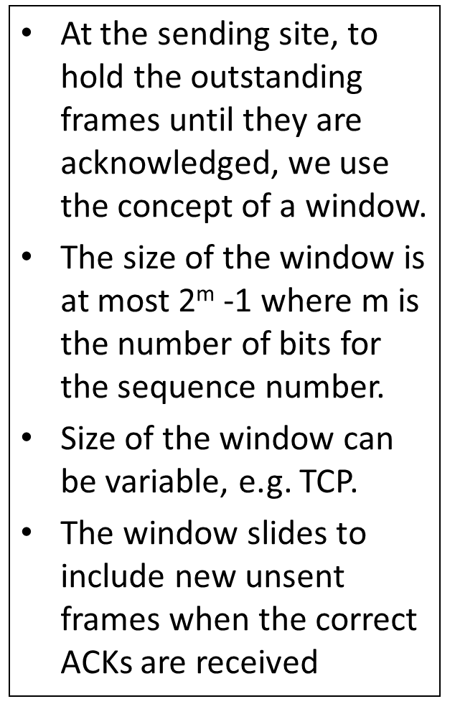
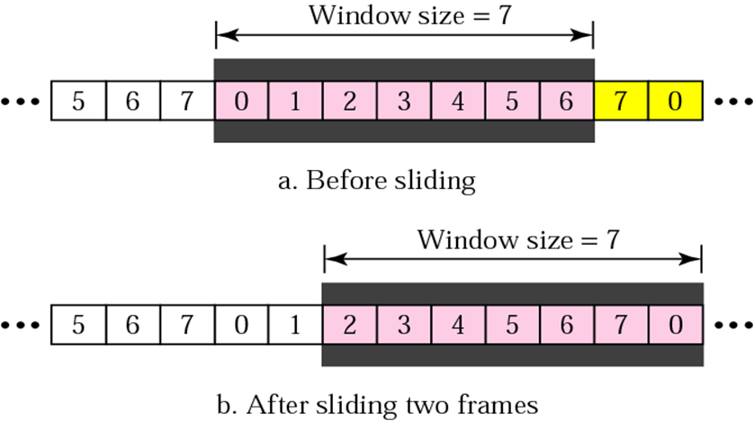
Sender Sliding Window

Slide 75
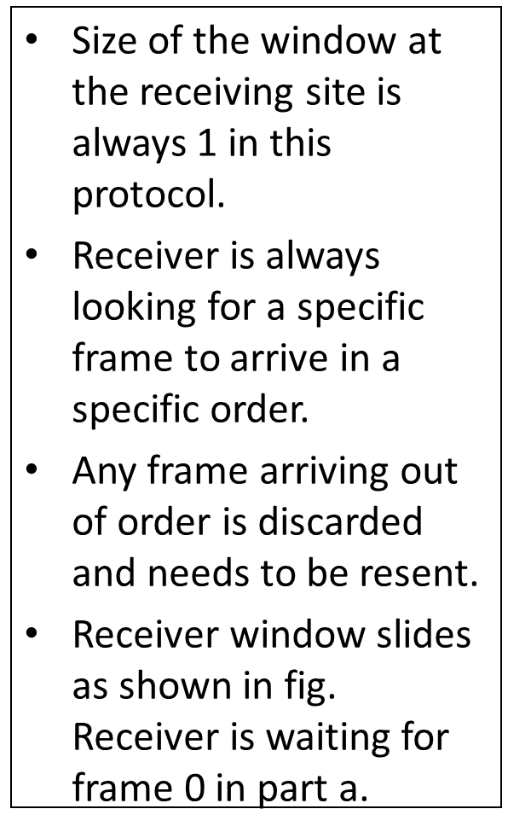
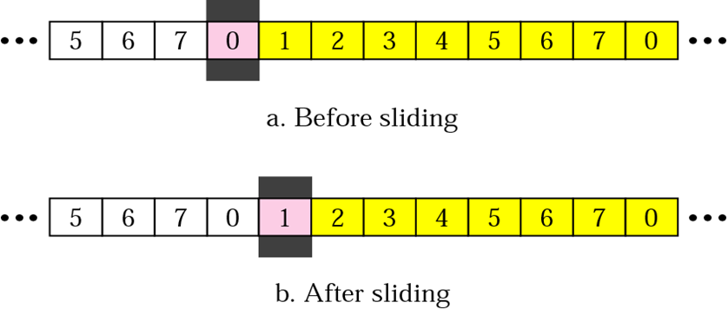
Receiver Sliding Window

Slide 76
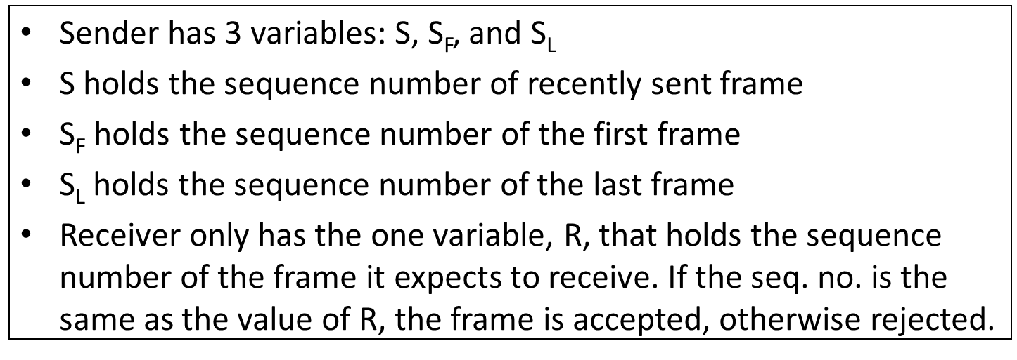
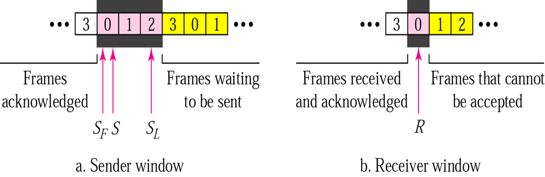
Control Variables

Slide 77
Acknowledgement
Receiver sends positive ACK if a frame arrived safe and in order.
If the frames are damaged/out of order, receiver is silent and discard all subsequent frames until it receives the one it is expecting.
The silence of the receiver causes the timer of the unacknowledged frame to expire.
Then the sender resends all frames, beginning with the one with the expired timer.
For example, suppose the sender has sent frame 6, but the timer for frame 3 expires (i.e. frame 3 has not been acknowledged), then the sender goes back and sends frames 3, 4, 5, 6 again. Thus it is called Go-Back-N-ARQ
The receiver does not have to acknowledge each frame received, it can send one cumulative ACK for several frames

Slide 78
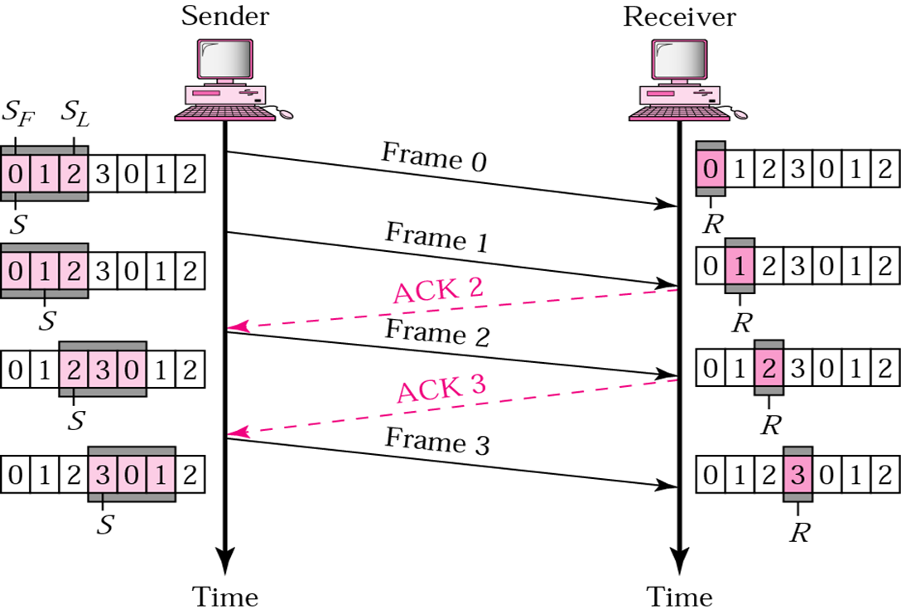
Go-Back-N ARQ, normal operation
The sender keeps track of the outstanding frames and updates the variables and windows as the ACKs arrive.

Slide 79
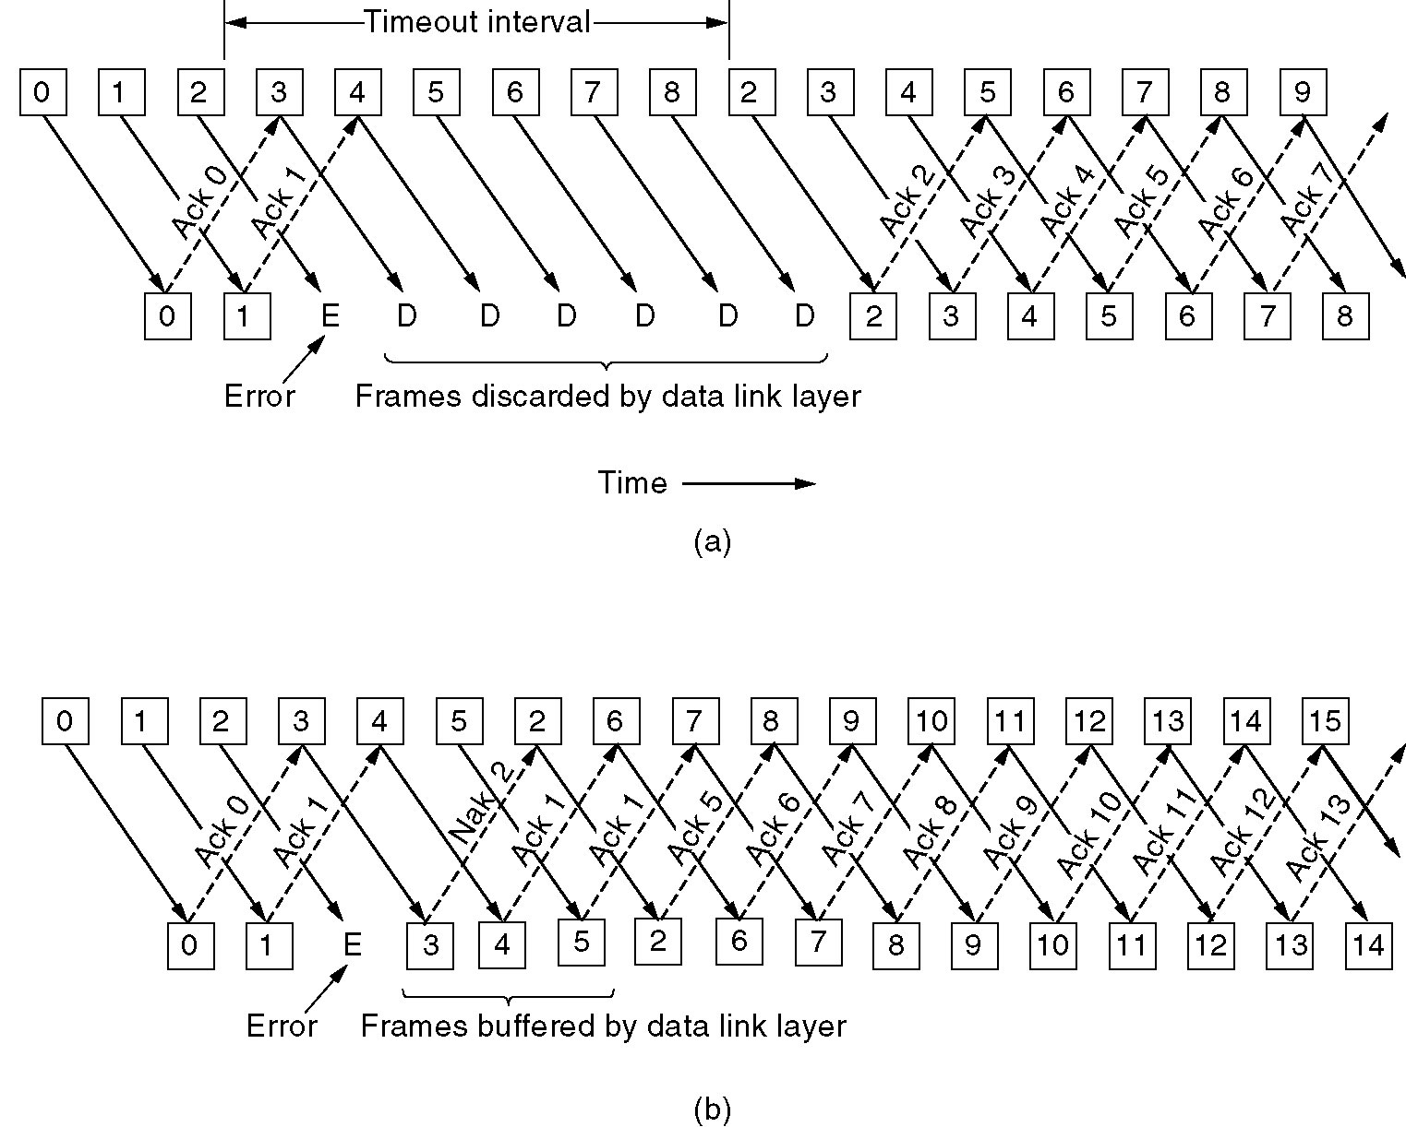
A Protocol Using Go Back N
Pipelining and error recovery. Effect on an error when
(a) Receiver’s window size is 1.

Slide 81
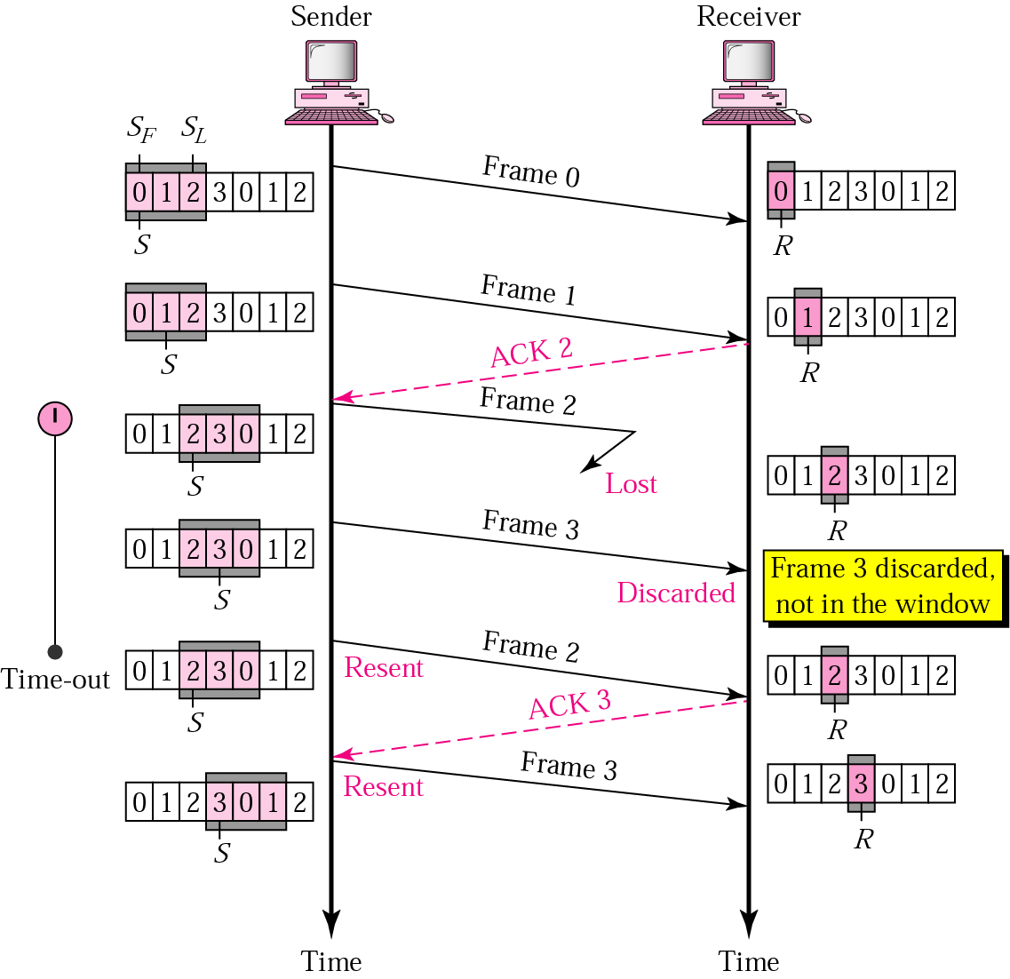
Go-Back-N ARQ, lost frame
Frame 2 is lost
When the receiver receives frame 3, it discards frame 3 as it is expecting frame 2 (according to window).
After the timer for frame 2 expires at the sender site, the sender sends frame 2 and 3. (go back to 2)

Slide 82
Go-Back-N ARQ, damaged/lost/delayed ACK
If an ACK is damaged/lost, we can have two situations:
If the next ACK arrives before the expiration of any timer, there is no need for retransmission of frames because ACKs are cumulative in this protocol.
If ACK1, ACK2, and ACk3 are lost, ACK4 covers them if it arrives before the timer expires.
If ACK4 arrives after time-out, the last frame and all the frames after that are resent.
Receiver never resends an ACK.
A delayed ACK also triggers the resending of frames

Slide 83
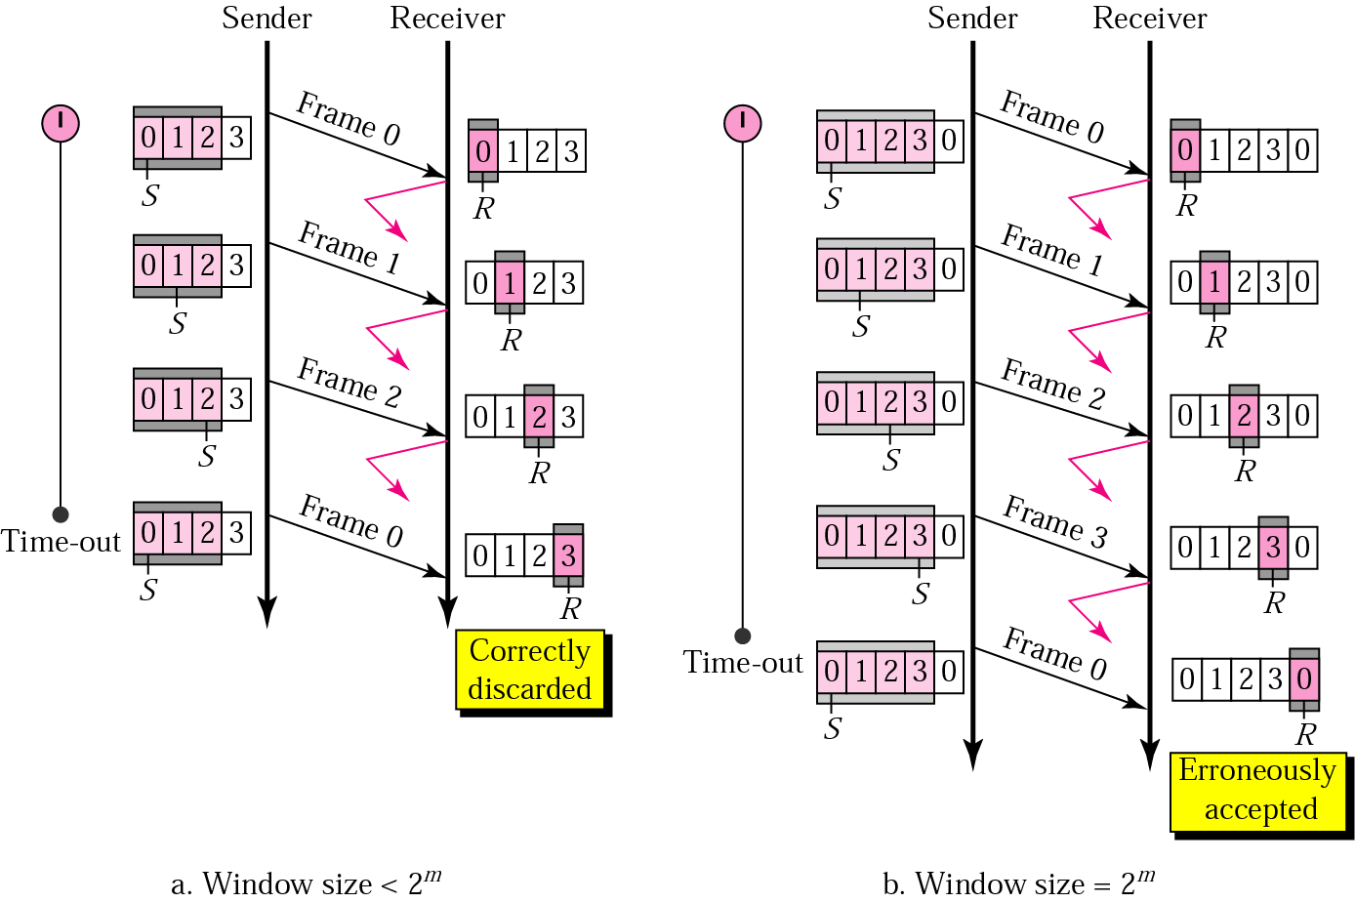
Go-Back-N ARQ, sender window size
Size of the sender window must be less than 2 ^{m}. Size of the receiver is always 1. If m = 2, window size = 2 ^{m} – 1 = 3.
Fig compares a window size of 3 and 4.
Accepts as the 1st frame in the next cycle-an error

Slide 84
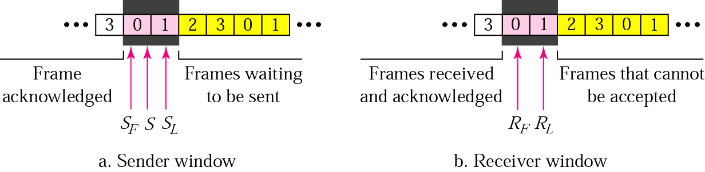
Selective Repeat ARQ, sender and receiver windows
Go-Back-N ARQ simplifies the process at the receiver site. Receiver only keeps track of only one variable, and there is no need to buffer out-of-order frames, they are simply discarded.
However, Go-Back-N ARQ protocol is inefficient for noisy link. It bandwidth inefficient and slows down the transmission.
In Selective Repeat ARQ, only the damaged frame is resent. More bandwidth efficient but more complex processing at receiver.
It defines a negative ACK (NAK) to report the sequence number of a damaged frame before the timer expires.

Slide 85
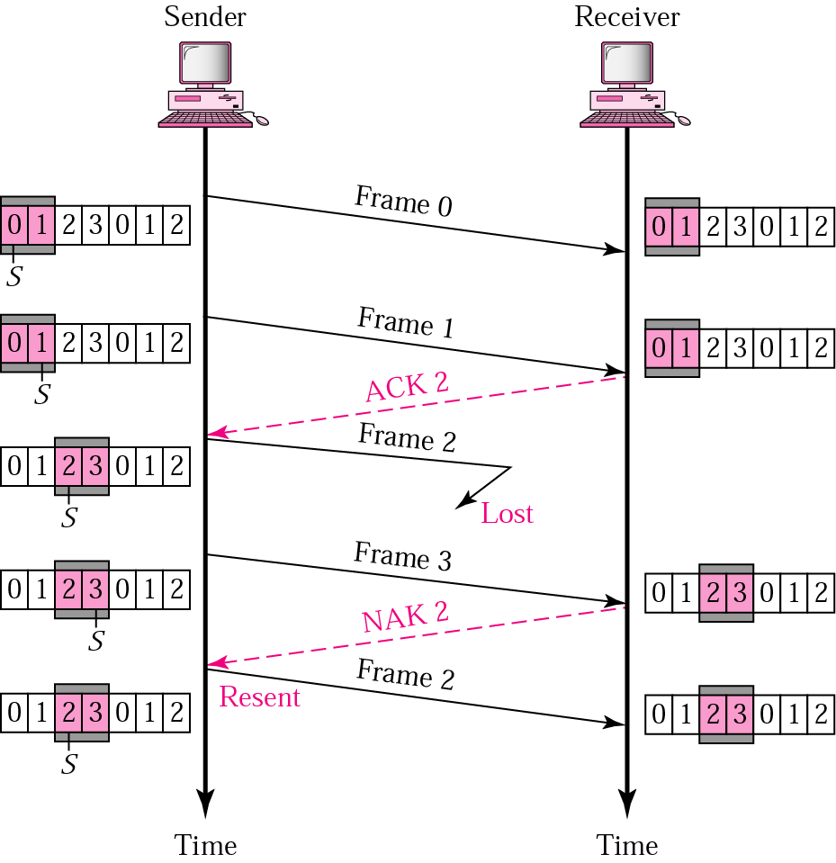
Selective Repeat ARQ, lost frame
Frames 0 and 1 are accepted when received because they are in the range specified by the receiver window. Same for frame 3.
Receiver sends a NAK2 to show that frame 2 has not been received and then sender resends only frame 2 and it is accepted as it is in the range of the window.

Slide 86
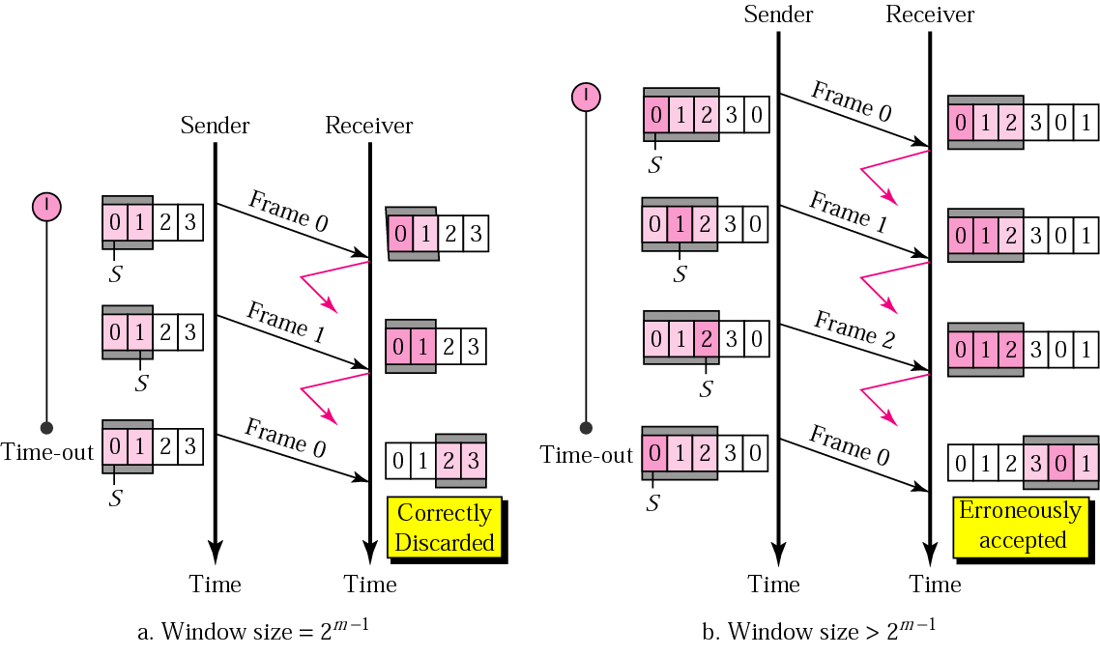
Selective Repeat ARQ, sender window size
Size of the sender and receiver windows must be at most one-half of 2 ^{m}. If m = 2, window size should be 2 ^{m} /2 = 2. Fig compares a window size of 2 with a window size of 3. Window size is 3 and all ACKs are lost, sender sends duplicate of frame 0, window of the receiver expect to receive frame 0 (part of the window), so accepts frame 0, as the 1st frame of the next cycle – an error.

Slide 87
Error and Flow Control Mechanisms
Stop-and-Wait
Go-Back-N ARQ
Selective-Repeat ARQ

Slide 88
Stop-and-Wait
Sender keeps a copy of the last frame until it receives an acknowledgement.
For identification, both data frames and acknowledgements (ACK) frames are numbered alternatively 0 and 1.
Sender has a control variable (S) that holds the number of the recently sent frame. (0 or 1)
Receiver has a control variable ® that holds the number of the next frame expected (0 or 1).
Sender starts a timer when it sends a frame. If an ACK is not received within a allocated time period, the sender assumes that the frame was lost or damaged and resends it
Receiver send only positive ACK if the frame is intact.
ACK number always defines the number of the next expected frame

Slide 89
Stop-and-Wait ARQ, lost ACK frame
When a receiver receives a damaged frame, it discards it and keeps its value of R.
After the timer at the sender expires, another copy of frame 1 is sent.

Slide 90
Stop-and-Wait, lost ACK frame
If the sender receives a damaged ACK, it discards it.
When the timer of the sender expires, the sender retransmits frame 1.
Receiver has already received frame 1 and expecting to receive frame 0 (R=0). Therefore it discards the second copy of frame 1.

Slide 91
Stop-and-Wait, delayed ACK frame
The ACK can be delayed at the receiver or due to some problem
It is received after the timer for frame 0 has expired.
Sender retransmitted a copy of frame 0. However, R =1 means receiver expects to see frame 1. Receiver discards the duplicate frame 0.
Sender receives 2 ACKs, it discards the second ACK.

Slide 92
Piggybacking
A method to combine a data frame with ACK.
Station A and B both have data to send.
Instead of sending separately, station A sends a data frame that includes an ACK.
Station B does the same thing.
Piggybacking saves bandwidth.

Slide 93
Disadvantage of Stop-and-Wait
In stop-and-wait, at any point in time, there is only one frame that is sent and waiting to be acknowledged.
This is not a good use of transmission medium.
To improve efficiency, multiple frames should be in transition while waiting for ACK.
Two protocol use the above concept,
Go-Back-N ARQ
Selective Repeat ARQ

Slide 94
Go-Back-N ARQ
We can send up to W frames before worrying about ACKs.
We keep a copy of these frames until the ACKs arrive.
This procedure requires additional features to be added to Stop-and-Wait ARQ.

Slide 95
Sequence Numbers
Frames from a sender are numbered sequentially.
We need to set a limit since we need to include the sequence number of each frame in the header.
If the header of the frame allows m bits for sequence number, the sequence numbers range from 0 to 2 ^{m} – 1. for m = 3, sequence numbers are: 1, 2, 3, 4, 5, 6, 7.
We can repeat the sequence number.
Sequence numbers are:
0, 1, 2, 3, 4, 5, 6, 7, 0, 1, 2, 3, 4, 5, 6, 7, 0, 1, …

Slide 96

Sender Sliding Window
At the sending site, to hold the outstanding frames until they are acknowledged, we use the concept of a window.
The size of the window is at most 2^{m} -1 where m is the number of bits for the sequence number.
Size of the window can be variable, e.g. TCP.
The window slides to include new unsent frames when the correct ACKs are received

Slide 97

Receiver Sliding Window
Size of the window at the receiving site is always 1 in this protocol.
Receiver is always looking for a specific frame to arrive in a specific order.
Any frame arriving out of order is discarded and needs to be resent.
Receiver window slides as shown in fig. Receiver is waiting for frame 0 in part a.

Slide 98

Control Variables
Sender has 3 variables: S, S_{F}, and S_{L}
S holds the sequence number of recently sent frame
S_{F} holds the sequence number of the first frame
S_{L} holds the sequence number of the last frame
Receiver only has the one variable, R, that holds the sequence number of the frame it expects to receive. If the seq. no. is the same as the value of R, the frame is accepted, otherwise rejected.

Slide 99
Acknowledgement
Receiver sends positive ACK if a frame arrived safe and in order.
If the frames are damaged/out of order, receiver is silent and discard all subsequent frames until it receives the one it is expecting.
The silence of the receiver causes the timer of the unacknowledged frame to expire.
Then the sender resends all frames, beginning with the one with the expired timer.
For example, suppose the sender has sent frame 6, but the timer for frame 3 expires (i.e. frame 3 has not been acknowledged), then the sender goes back and sends frames 3, 4, 5, 6 again. Thus it is called Go-Back-N-ARQ
The receiver does not have to acknowledge each frame received, it can send one cumulative ACK for several frames.

Slide 100

Go-Back-N ARQ, normal operation
The sender keeps track of the outstanding frames and updates the variables and windows as the ACKs arrive.

Slide 101
Go-Back-N ARQ, lost frame
Frame 2 is lost
When the receiver receives frame 3, it discards frame 3 as it is expecting frame 2 (according to window).
After the timer for frame 2 expires at the sender site, the sender sends frame 2 and 3. (go back to 2)

Slide 102
Go-Back-N ARQ, damaged/lost/delayed ACK
If an ACK is damaged/lost, we can have two situations:
If the next ACK arrives before the expiration of any timer, there is no need for retransmission of frames because ACKs are cumulative in this protocol.
If ACK1, ACK2, and ACk3 are lost, ACK4 covers them if it arrives before the timer expires.
If ACK4 arrives after time-out, the last frame and all the frames after that are resent.
Receiver never resends an ACK.
A delayed ACK also triggers the resending of frames

Slide 103
Go-Back-N ARQ, sender window size
Size of the sender window must be less than 2 ^{m}. Size of the receiver is always 1. If m = 2, window size = 2 ^{m} – 1 = 3.
Fig compares a window size of 3 and 4.
Accepts as the 1st frame in the next cycle-an error

Slide 104
Selective Repeat ARQ, sender and receiver windows
Go-Back-N ARQ simplifies the process at the receiver site. Receiver only keeps track of only one variable, and there is no need to buffer out-of-order frames, they are simply discarded.
However, Go-Back-N ARQ protocol is inefficient for noisy link. It bandwidth inefficient and slows down the transmission.
In Selective Repeat ARQ, only the damaged frame is resent. More bandwidth efficient but more complex processing at receiver.
It defines a negative ACK (NAK) to report the sequence number of a damaged frame before the timer expires.

Slide 105
Selective Repeat ARQ, lost frame
Frames 0 and 1 are accepted when received because they are in the range specified by the receiver window. Same for frame 3.
Receiver sends a NAK2 to show that frame 2 has not been received and then sender resends only frame 2 and it is accepted as it is in the range of the window.

Slide 106
Selective Repeat ARQ, sender window size
Size of the sender and receiver windows must be at most one-half of 2 ^{m}. If m = 2, window size should be 2 ^{m} /2 = 2. Fig compares a window size of 2 with a window size of 3. Window size is 3 and all ACKs are lost, sender sends duplicate of frame 0, window of the receiver expect to receive frame 0 (part of the window), so accepts frame 0, as the 1st frame of the next cycle – an error.

